Slide 1
Timeline
DATE | TOPICS | RELATED TOPIC
05/5/2025 – 09/5/2025 | Basic transformations: Negative, Power Law, Log, Piecewise Linear stretching, Thresholding. Histogram analysis: Histogram Equalization, Histogram Matching, Contrast Local Adaptive Histogram Equalization. | Basic transformations & Histogram analysis
12/5/2025 - 16/5/2025 | Correlation and Convolution, Box filter, Gaussian Filter, Median filter. Resize images, Nearest Neighbor Interpolation, Linear Interpolation, Bilinear Interpolation. | Fundamentals of Spatial filtering
19/5/2025 – 21/5/2025 22/5/2025 – 23/5/2025 | Sobel filter: Derivative in detecting edge, Gradient, Sensitivity of derivatives to noise, Sobel Filter Program Bilateral filter: Compare Bilateral Filter and Gaussian Filter, My implementation program | Sobel filter Bilateral filter
26/5/2025 – 28/5/2025 29/5/2025 – 30/5/2025 | Canny edge detecting: Gradient, Non-Maximum Suppression, Hysteresis threshold, My implementation program Morphological Image Processing: Dilation, Erosion, Opening, Closing | Canny edge detecting, Morphological Image Processing
02/6/2025 – 04/6/2025 | Morphological Image Processing: Hit or miss transform, Boundary Extraction, Thinning, Skeleton. | Morphological Image Processing

Slide 2
MORPHOLOGICAL IMAGE PROCESSING

Slide 3

Introduction
The word morphology commonly denotes a branch of biology that deals with the form and structure of animals and plants
We use the same word here in the context of mathematical morphology as a tool for extracting image components that are useful in the representation and description of region shape, such as
Boundaries extraction
Skeletons
Convex hull.
Morphological filtering
Thinning
Pruning
The operation are particularly useful for the analysis of binary images
Notes:
Morphology in image processing is a tool for extracting image components that are useful in the representation and description of region shape, such as boundaries and skeletons.
•Furthermore, the morphological operations can be used for filtering, thinning and pruning.

Slide 4
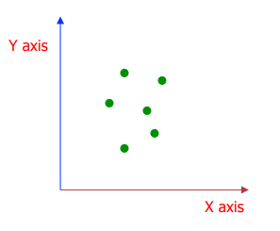
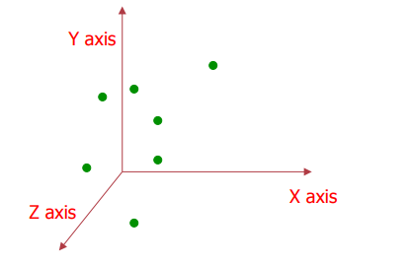


Representing Objects by sets
The language of mathematical morphology is set theory Objects in an image are represented by sets in mathematical morphology.
Binary image: the element of the set is the coordinates (x, y) of pixel belong to the object $Z^{2}$
Gray-scaled image: the element of the set is the coordinates (x, y) of pixel belong to the object and the gray levels $Z^{3}$
$$Z^{2}$$
$$Z^{3}$$
Notes:
The language of mathematical morphology is set theory. As such, morphology offers a unified and powerful approach to numerous image processing problems. When working with images, sets in mathematical morphology represent objects in those images. In binary images, the sets in question are members of the 2-D integer space Z2, where each element of a set is a tuple (2-D vector) whose coordinates are the coordinates of an object (typically foreground) pixel in the image. Grayscale digital images can be represented as sets whose components are in Z3. In this case, two components of each element of the set refer to the coordinates of a pixel, and the third corresponds to its discrete intensity value. Sets in higher dimensional spaces can contain other image attributes, such as color and time-varying components.

Slide 5
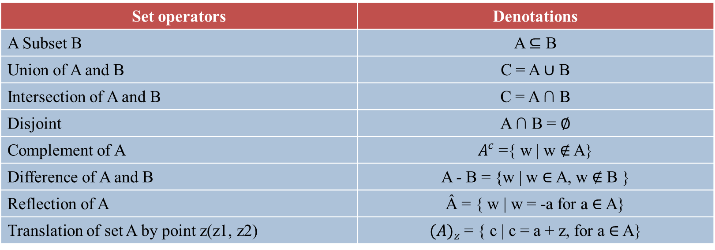
Representing Objects by sets
Basic Set Operators
Set operators | Denotations
A Subset B | A ⊆ B
Union of A and B | C = A ∪ B
Intersection of A and B | C = A ∩ B
Disjoint | A ∩ B = ∅
Complement of A | $A^{c}$ ={ w | w ∉ A}
Difference of A and B | A - B = {w | w ∈ A, w ∉ B }
Reflection of A | Â = { w | w = -a for a ∈ A}
Translation of set A by point z(z1, z2) | ${(A)}_{z}$= { c | c = a + z, for a ∈ A}
Notes:
Here are the definitions and notations for some Basic Set Operators.

Slide 6

Basic Set Theory
A
A
A
A ∪ B
A ∩ B
B
B
B
Union of A and B
Intersection of A and B
B
A
A
A
A – B
B
$A^{c}$
Complement of A
B Subset A
Difference of A and B
Notes:
This is an illustration of Basic Set Theory, in which Set A and Set B are represented by two shapes like this
Union of A and B: The union of two sets A and B is a set containing all elements that belong to A, or to B, or to both A and B.
The intersection of two sets A and B is a set containing all elements that belong to both A and B.
The complement of a set A is the set of all elements that are not in A.
B Subset A
This means that every element of set B is also an element of set A. In other words, if x∈B, then x∈A. In the diagram, the shape of B is entirely contained within the shape of A.
A transformation that moves every point of a figure or a space by the same distance in a given direction.
The difference of set A and set B is the set of all elements that belong to A but do not belong to B.

Slide 7
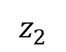

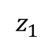
Translation and Reflection
Translation of set A by point z($z_{1}$, $z_{2}$)
${(A)}_{z}$= { c | c = a + z, for a ∈ A}
Reflection of A (rotation by 180° about the origin)
Â = { w | w = -a for a ∈ A}
$$z_{2}$$
$$z_{1}$$
Â
A
Reference point
Notes:
A transformation that moves every point of a figure or a space by the same distance in a given direction. It's essentially "sliding" the object.
Reflection "Flipping" a figure over the origin, or equivalently, rotating it 180 degrees about the origin. This changes the orientation of the figure.

Slide 8
Logic Operations
p | q | AND p . q | OR p + q | XOR | NAND | NOT p
0 | 0 | 0 | 0 | 0 | 1 | 1
0 | 1 | 0 | 1 | 1 | 1 | 1
1 | 0 | 0 | 1 | 1 | 1 | 0
1 | 1 | 1 | 1 | 0 | 0 | 0
Notes:
basic bitwise logic operations
The AND operation returns 1 only if both bits are 1.
The OR operation returns 1 if at least one of the bits is 1.
XOR returns 1 only when the two bits are different.
NOT flips the bit: 1 to zero and zero to 1
NAND means "Not AND" — it gives the opposite of AND. It returns 0 only if both inputs are 1, otherwise it returns 1.

Slide 9
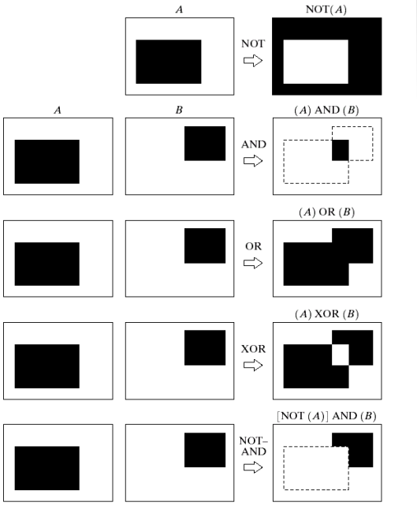
Logic Operations
Notes:
"This is an image illustrating bitwise operations in image processing.“
First, it apply the NOT operation to A, which means invert it. do an AND operation between this inverted A and the image B.
It corresponds to B minus the overlapping area with A.

Slide 10
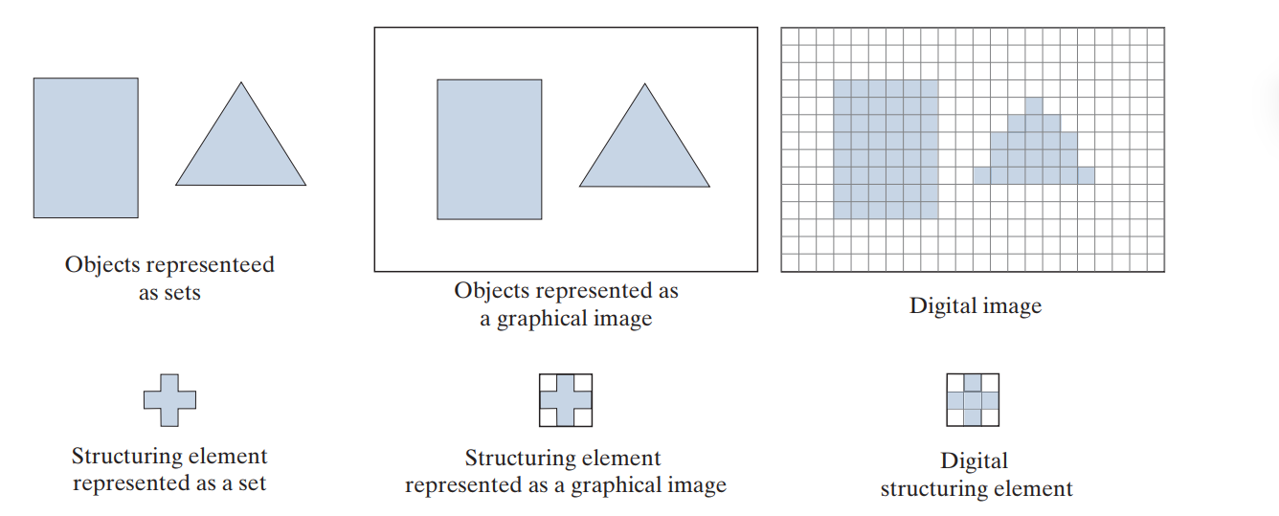
Structuring element
In image processing, we use morphology with two types of sets of pixels:
objects
structuring elements (SE’s).
Background
Image
Foreground
Foreground
Structuring element
Structuring elements are used in a form similar to spatial convolution kernels The image border just described is similar to the padding we discussed in Spatial filtering.
The Spatial filter operations are different in morphology, but the padding and sliding operations are the same as in convolution.
Notes:
In image processing, we use morphology with two types of sets of pixels: Objects and Structuring elements: These are small "templates," typically simple shapes (like squares, circles, crosses, etc.), used to probe or interact with the objects in the image.
The upper part of the diagram illustrates how an image is represented in morphological processing and The lower part of the diagram illustrates the structuring element.
There is an important difference between the way we represent digital images and digital structuring elements. Observe on the top right that there is a border of background pixels surrounding the objects, while there is none in the SE.
Structuring elements are used in a form similar to spatial convolution kernels The image border just described is similar to the padding we discussed in Spatial filtering.
The Spatial filter operations are different in morphology, but the padding and sliding operations are the same as in convolution.

Slide 11
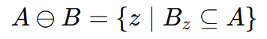
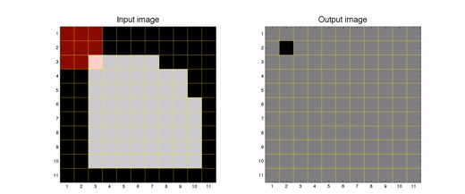

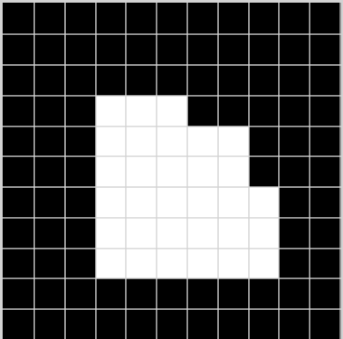

Erosion
Erosion is a fundamental morphological operation used to shrink the foreground. The erosion of A by B is the set of all points z such that B, translated by z, is contained in A.
A is a set of foreground pixels
B is a structuring element
Erosion "shrinks" white (foreground) regions.
It removes boundary pixels of objects.
Useful for eliminating small white noises and separating touching objects.
Origin
SE
Input Image
Output Image
Notes:
Simple terms, during the morphological erosion operation, the structuring element (SE) is translated over each pixel of the image. The pixel corresponding to the center of the SE is retained only if all pixels within the SE fit entirely within the object region. If the SE is not completely contained within the object region, the center pixel is set to the background.

Slide 12
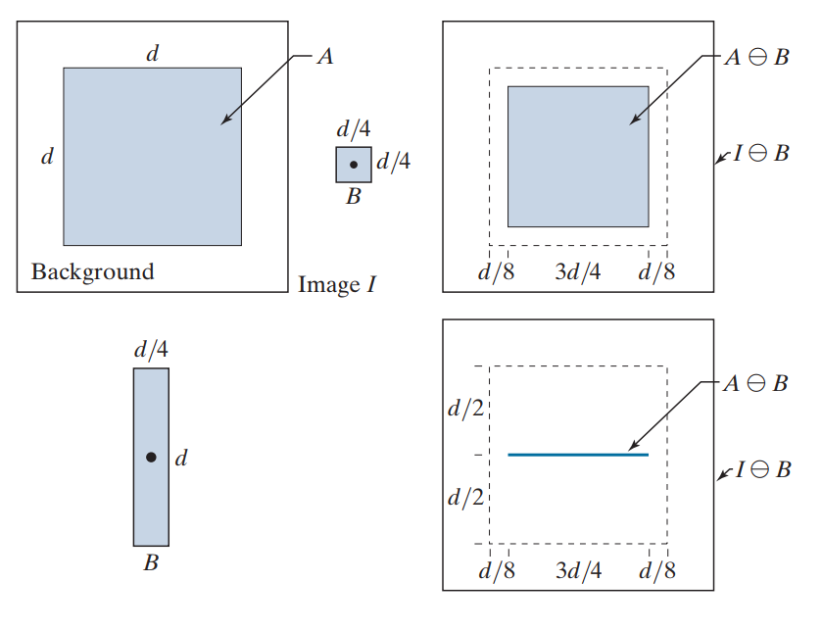
Erosion
Square SE, B (the dot is the origin).
Elongated SE.
Notes:
This is an example of applying erosion with different shaped structuring elements (SE). The top image shows the result of eroding Image using a square SE, while the bottom image shows the result of erosion with an elongated SE. The dotted border represents the boundary of set A, shown for reference.
We can observe that in the top image, the boundary of the object is only slightly eroded, resulting in a shape that remains square. However, in the bottom image, the result is a line.
As you can see, the result of erosion is controlled by the shape of the structuring element.
Structuring elements commonly have shapes such as square, circle, or cross.

Slide 13




Using erosion to remove image components.
486x486 binary image
Image eroded using
square SE size 11x11
Image eroded using
square SE size 15x15
Image eroded using
square SE size 45x45
Notes:
This is a binary image depicting a simple wire-bond mask. Our goal is to remove the connecting lines between the center region and the border pads.
Eroding the image with a square structuring element of size 11×11, where all elements are 1, yields the result shown in the second image. Most of the lines are removed, but two still remain. This is because those two lines have a thickness greater than 11 pixels.
By increasing the structuring element size to 15×15, all lines are successfully eliminated. Increasing the size of the structuring element even further will remove larger components. For instance, using a 45×45 structuring element will also eliminate the border pads entirely.

Slide 14
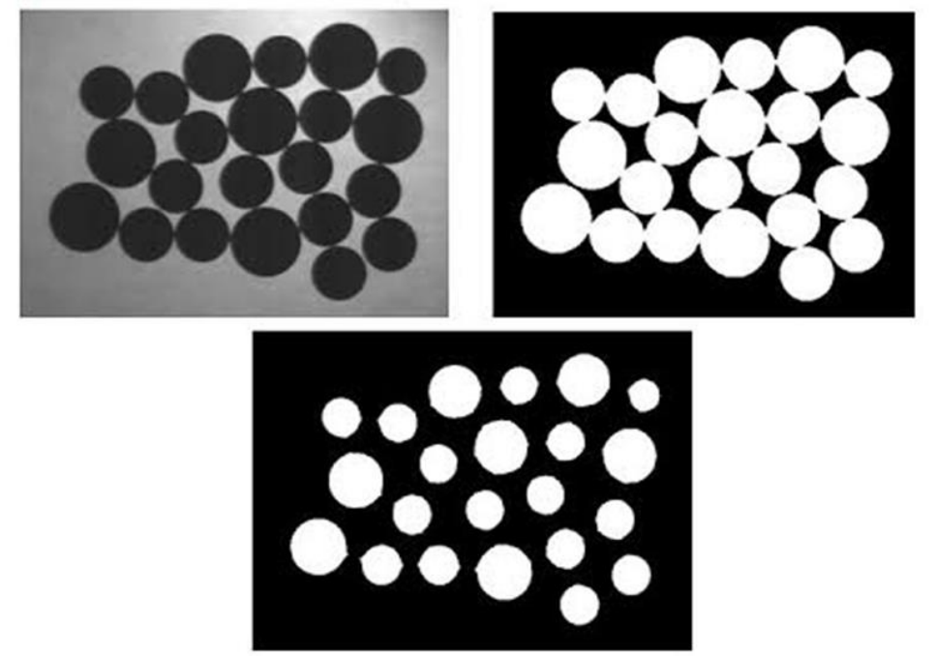
Separating the objects using erosion

Slide 15
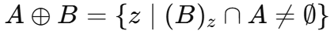
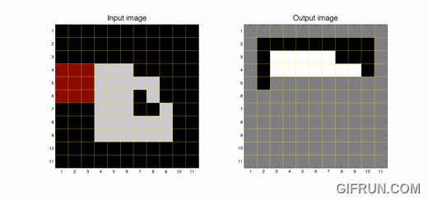

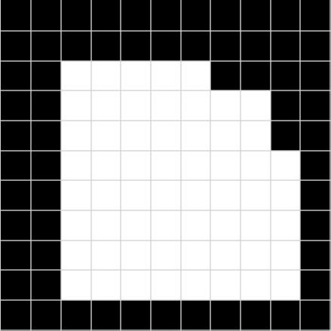
Dilation
Dilation is a fundamental morphological operation used to expand the foreground. The dilation of image A by structuring element B is the set of all points z such that the translated structuring element ${(B)}_{z}$overlaps with at least one foreground pixel in A.
A is a set of foreground pixels
B is a structuring element
Enlarges bright objects in binary images.
Connects broken parts
Fills small holes or gaps.
Origin
SE
Input Image
Output Image
Notes:
Dilation is similar to erosion, but instead of shrinking the foreground, dilation expands it. The dilation of an image A by a structuring element B is defined as the set of all points z such that the translated structuring element Bₓ overlaps with at least one foreground pixel in A.
In simple terms, during the morphological dilation operation, the structuring element (SE) is translated over each pixel of the image. The pixel corresponding to the center of the SE is set to foreground if at least one pixel within the SE overlaps with a foreground (object) pixel in the image. If none of the pixels in the SE overlap with the foreground, the center pixel is set to background.

Slide 16
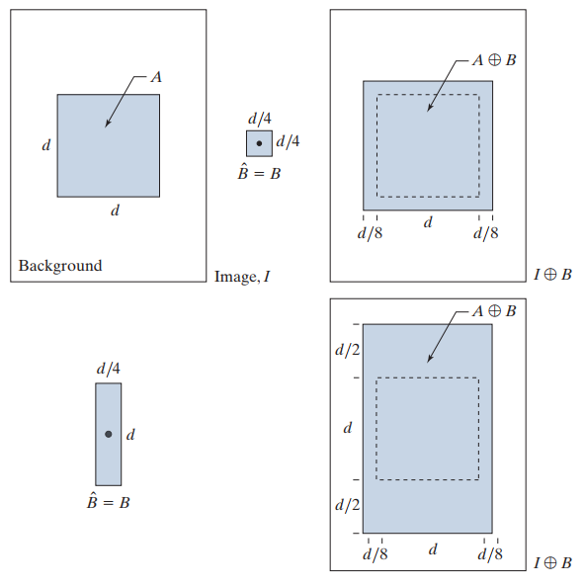
Dilation
Square SE, B (the dot is the origin).
Elongated SE.
Notes:
This is an example of applying dilation with different shaped structuring elements (SE).

Slide 17
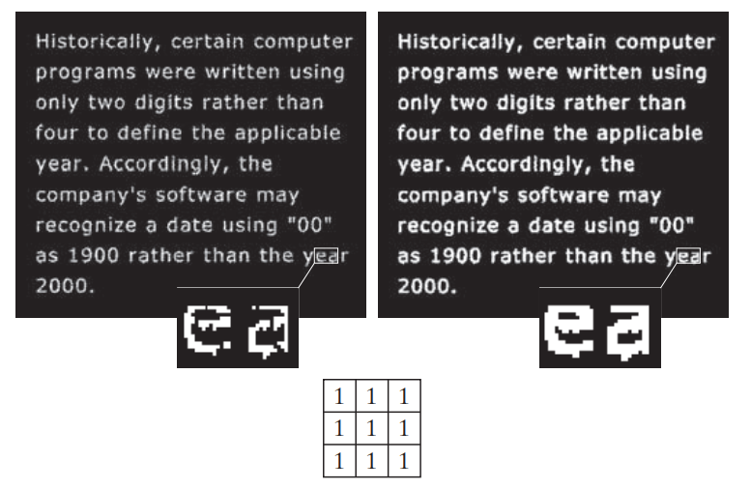
Dilation
Notes:
This is an example demonstrating the effect of dilation.
On the right The characters appear thicker, more solid, and more continuous compared to the image on the left. Small gaps inside the characters have been filled in.

Slide 18
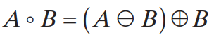

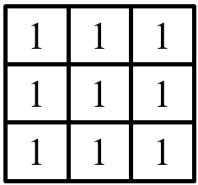
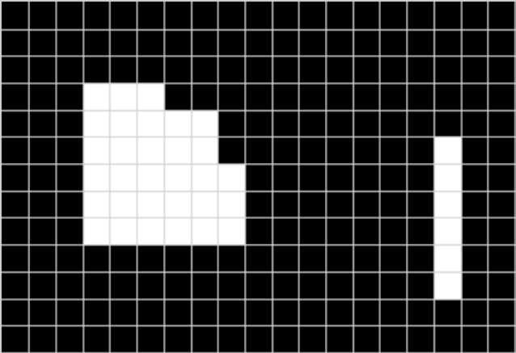
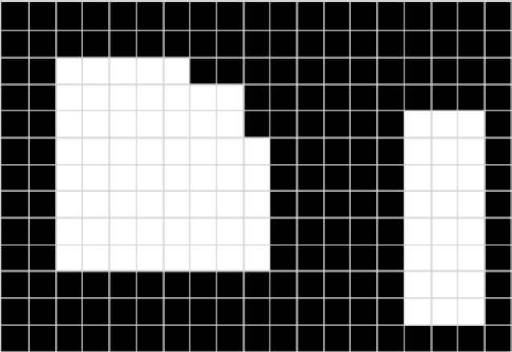
Opening
Noise
Structure element B
Structure element B
Erosion
Dilation
Original image
Result after applying
Opening operation
Step 1: Erosion
Remove small noise.
Smooth object contours.
Separate closely spaced objects.
Step 2: Dilation
Restore the main shape without recovering the noise.
Notes:
Previously, we explored the two fundamental morphological operations: erosion and dilation. Now, we will move on to two compound operations — opening and closing — which are combinations of erosion and dilation.
Opening consists of erosion followed by dilation. It is typically used to:
Remove small noise
Smooth object contours
Separate closely spaced objects
After the erosion step removes noise and small protrusions, the dilation step is applied to restore the main shape of the object — without bringing back the noise.

Slide 19
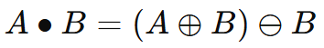
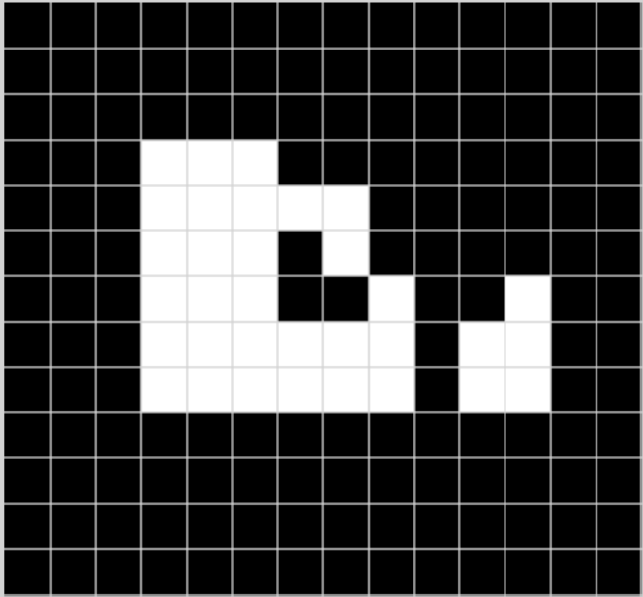
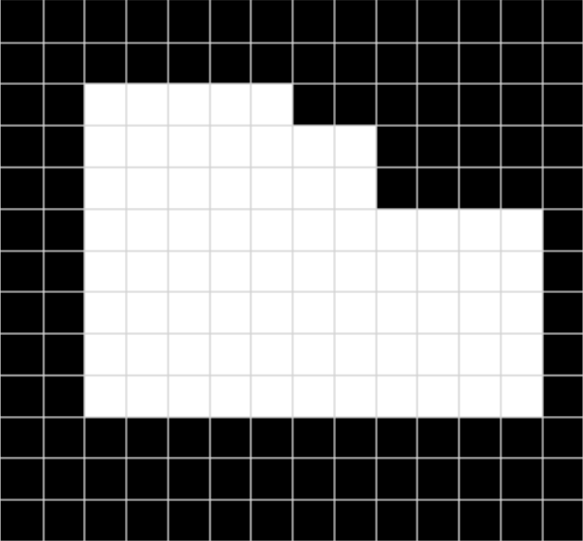
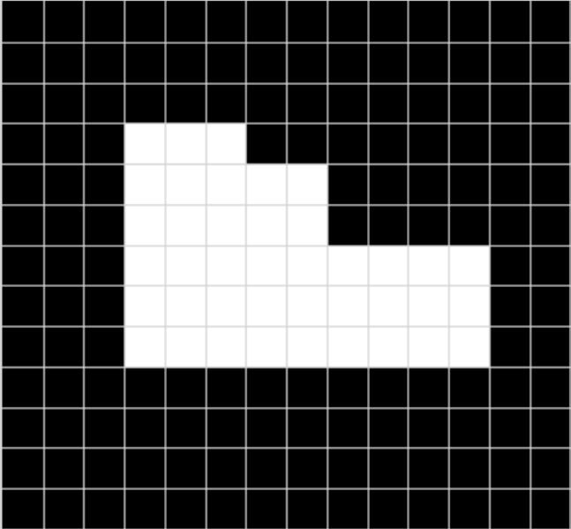
Closing
Structure element B
Structure element B
Dilation
Erosion
Original image
Result after applying
Closing operation
Step 2: Erosion
shrink the objects back to their original size,
while maintaining the connections and filled areas created by dilation.
Step 1: Dilation
Fill holes or gaps.
Connect nearby objects.
Notes:
Closing is the reverse of opening — it consists of dilation followed by erosion. This operation is particularly useful for:
Filling small holes or gaps within objects
Connecting nearby objects
Smoothing object contours from the opposite direction of opening
In the first step, dilation expands the foreground regions, filling in small holes and connecting nearby elements. Then, erosion is applied to shrink the objects back to their original size, while maintaining the connections and filled areas created by dilation.

Slide 20


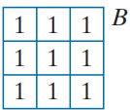


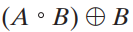



Program to process fingerprint images
Threshold
Original Image
Binary Image
Result
Notes:
I have developed a program to process fingerprint images using morphological operations. First, this is the original scene that I cropped using the snipping tool from a document. To convert it into a binary image, I applied threshold transformation. I applied erosion to remove small noise, then used dilation to restore the original shape of the fingerprint. What I just performed is an opening operation. The result is that the noise was removed; however, the image still has many holes and breaks.
Next, I applied dilation to the obtained result to fill in the gaps, followed by erosion to restore the original shape of the fingerprint. This is the closing operation. Applying opening together with closing helped me achieve a result of a continuous, clear fingerprint image without noise. However, my result still has some noise in certain areas because I chose a structuring element (SE) that is not optimal, but overall, the image has improved.

Slide 21
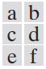
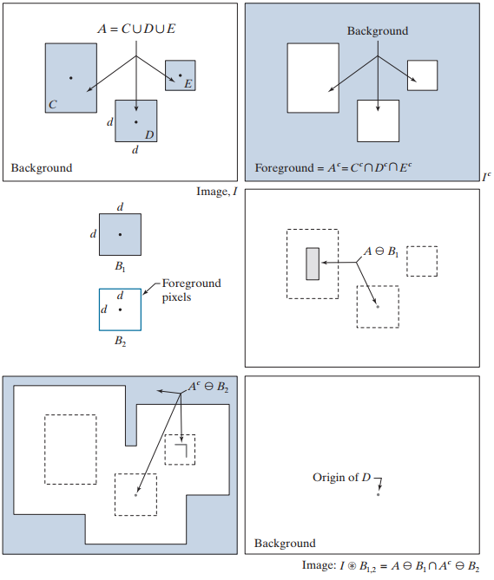
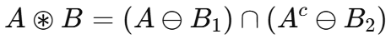
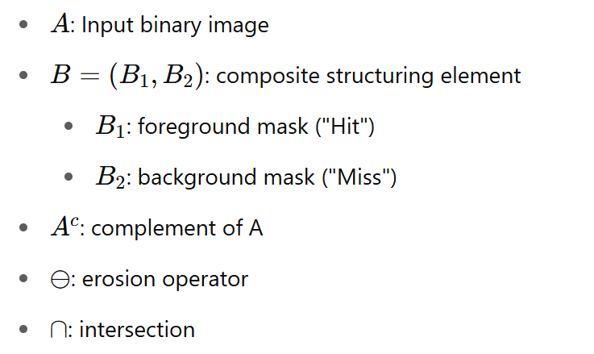
Hit or Miss transform
The morphological hit-or-miss transform (HMT) is a basic tool for shape detection.
The HMT utilizes two structuring elements:
B1 for detecting shapes in the foreground
B2 for detecting shapes in the background.
The HMT of image I is defined as:
Notes:
The Hit-or-Miss Transform (HMT) is a binary image processing technique used to precisely detect specific patterns or shapes in an image.
Conceptually, the operation involves two simultaneous erosions:
One erosion is applied to the original image (foreground) using a structuring element to ensure the pattern fits perfectly in the foreground.
At the same time, the complement of the image is eroded using another structuring element, to ensure the background fits the "Miss" positions.
The final result is the intersection of the two erosions. If both the foreground and background match at a certain position, it is identified as a perfect match for the target pattern.
🔸 Example illustrating the concepts of HMT:
In this example, the input binary image A contains three separate foreground regions: C, D, and E.
Here, D is the small square object we want to detect.
C and E are unwanted structures or noise.
Each region includes a black dot indicating the origin of the object.
To locate D in the foreground, we perform erosion of A using a structuring element B1, where B1 is equal in shape to D.
The figure shows that this erosion returns a single point at the origin of D – which is what we expect. However, it also includes parts of region C, because C is larger than D, so the shape of D can fit inside C in some places.
→ This demonstrates that just checking the foreground is not enough - we might make mistakes and detect the wrong object.
To find the true location of D, we must also consider the background.
We take the complement of image A, meaning all foreground pixels become background and vice versa.
Then, we erode the complemented image with a structuring element B2, designed to fit the border of D in the background.
B2 consists of a rectangle one pixel thick, surrounding the size of D.
As shown in the figure, the erosion result includes the origin of D, but may also include parts of Ac and C.
In the end, only one point is common between the two erosion results — this point is exactly the origin of object D.
→ Therefore, the intersection of these two erosions is the final output of the Hit-or-Miss Transform. It tells us exactly where the shape D is located in the image.

Slide 22
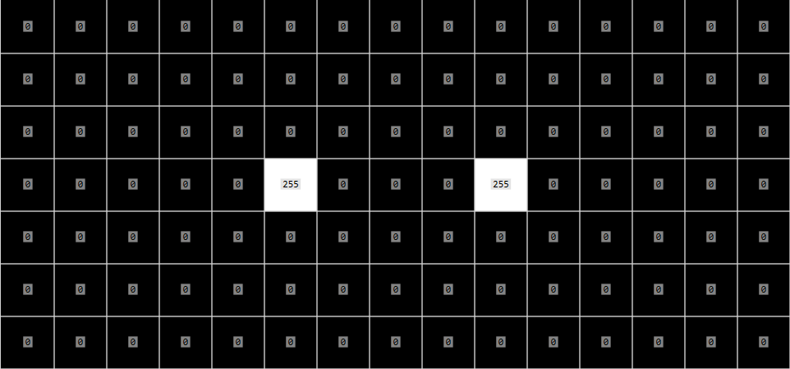

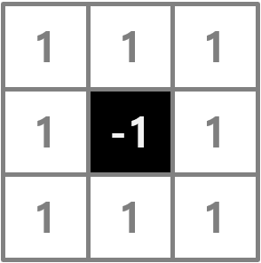
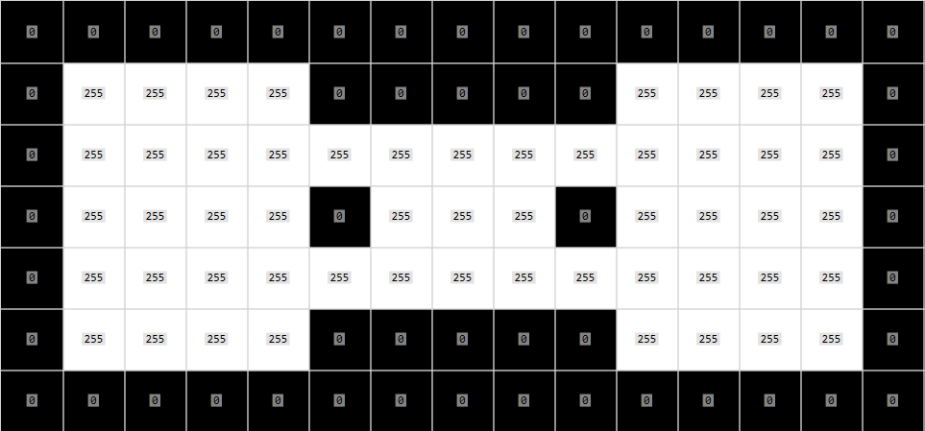
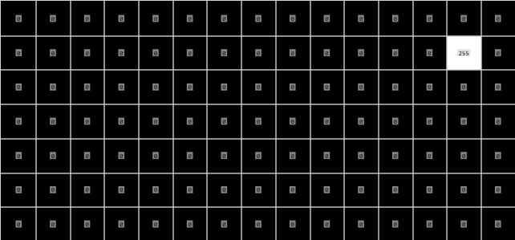
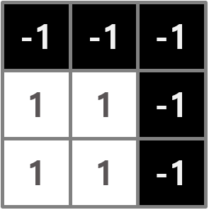
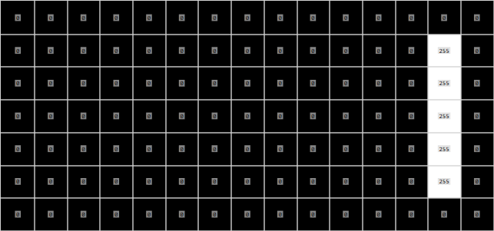
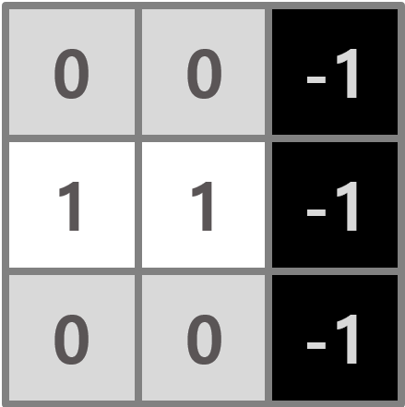
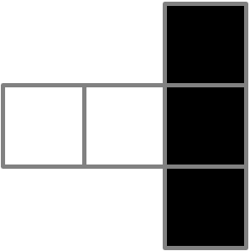
Hit or Miss transform example
1 : Foreground
-1: Background
0 : Don’t care

Slide 23
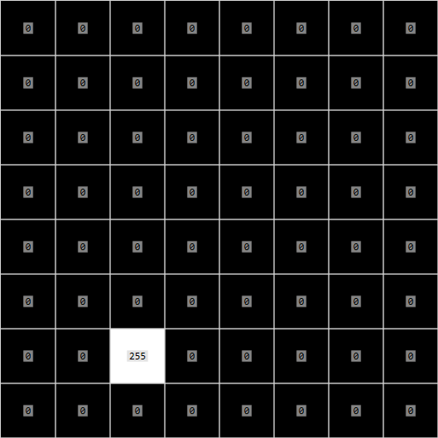
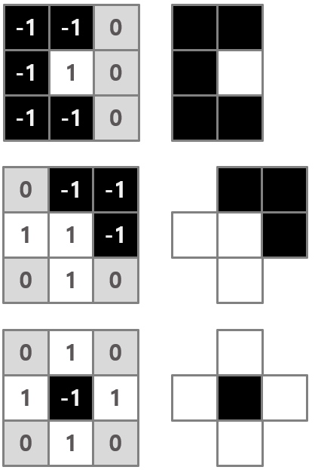
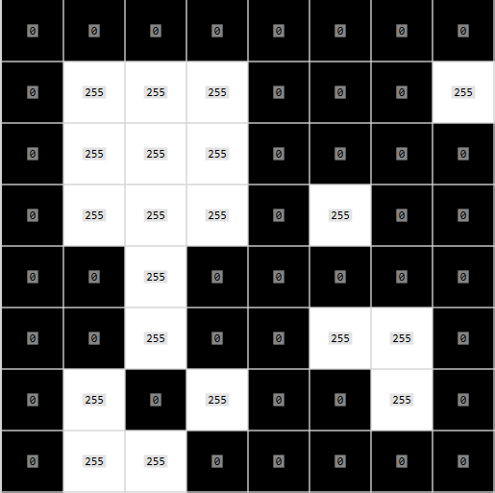
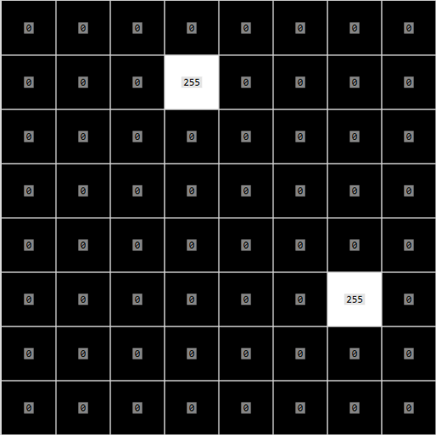
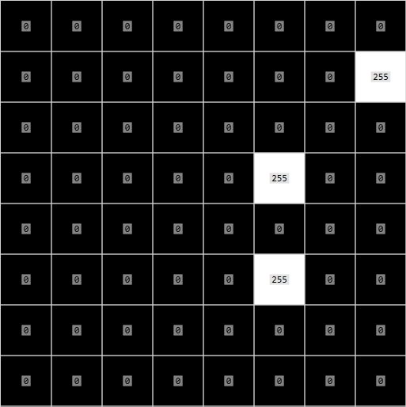
Hit or Miss transform example

Slide 24

Boundary extraction
Boundary extraction is a key technique in image processing used for:
Separating objects from the background.
Detecting object shapes and contours.
Preprocessing for recognition or object detection tasks.
Two common methods:
Outer boundary using erosion:
Morphological gradient:
A binary image.
Result of
Boundary extraction
Notes:
There are two common methods:
The first method is to subtract the eroded image from the original image. During erosion, the object shrinks as pixels near the edges are removed. The lost pixels represent the object’s boundary. Therefore, by subtracting the eroded image from the original, we obtain a thin outline around the object, called the outer boundary. This boundary helps clearly define the shape and edges of the object.
The second method is the morphological gradient. This technique extracts the boundary by subtracting the eroded image from the dilated image. During dilation, the object expands outward, while during erosion, it shrinks inward. The difference between these two results represents the boundary region, including both the outer and inner edges. Thus, the gradient gives a clearer and thicker outline that highlights the entire boundary of the object — both inside and outside the original shape.

Slide 25
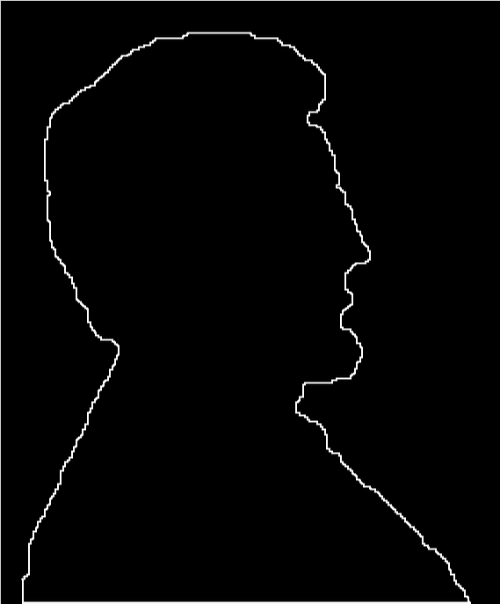
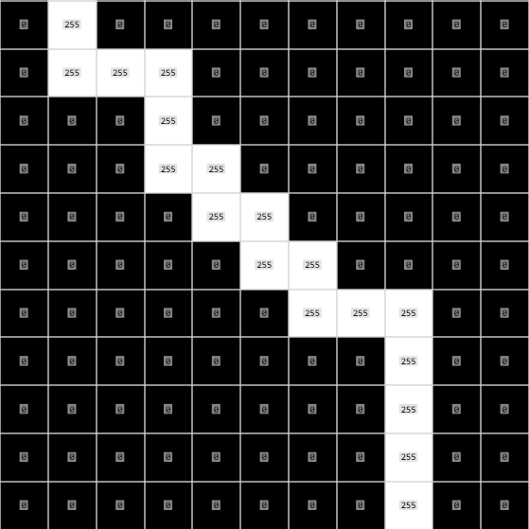



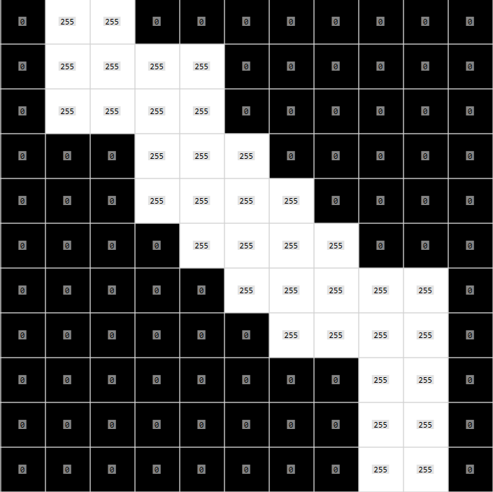
Boundary extraction
Outer boundary using erosion:
Thin boundary.
Fully within the original object.
Useful for shape detection and binary segmentation.
B
Morphological gradient:
Thicker boundary.
May include pixels outside the original object.
Useful for edge enhancement and contour emphasis.
Image I

Slide 26
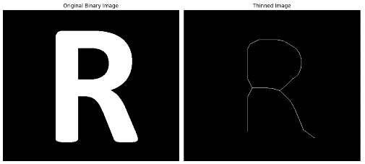
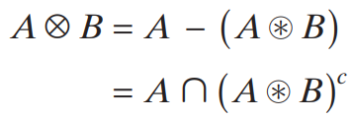
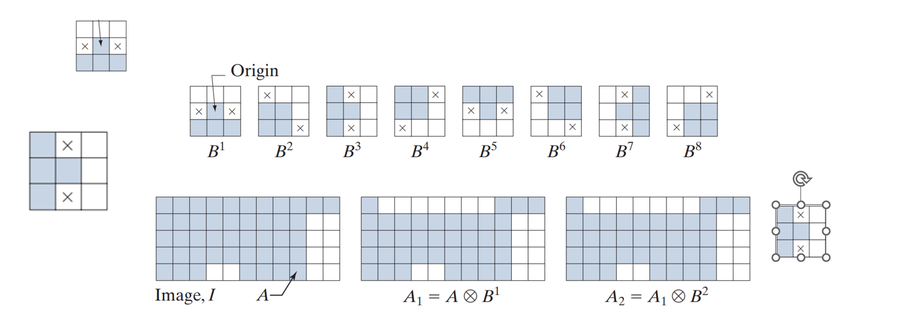



Thinning
Thinning is a morphological operation that preserves the structure and connectivity of an object while removing edge pixels. The result is a skeletal representation, or the 'skeleton', of the original shape.
The thinning operation uses the hit-or-miss transform with 8 different structuring element patterns. In each iteration, the process follows the formula:
Set of structure element:
Origin
0°
45°
90°
135°
180°
225°
270°
315°
Background
0°
B1
Foreground
Notes:
"Each structuring element represents a specific direction (0°, 45°, 90°, ..., 315°). Each iteration applies the thinning operation 8 times — once for each structuring element — to remove edge pixels in different directions.“
Trong phương pháp này, chúng ta dùng 8 cấu trúc phần tử quay theo 8 hướng chính, để tìm và loại bỏ các pixel rìa mà vẫn giữ nguyên hình dạng khung xương. Mỗi structuring element tìm các mẫu cụ thể của pixel cần xóa, ví dụ: pixel thừa ở cạnh trái, góc trên phải,… Sau 8 lần áp dụng, ta thu được ảnh đã được làm mỏng."

Slide 27













Thinning program

Slide 28





Skeletonizaton
The skeleton of A can be expressed in terms of erosions and openings. That is, it can be shown (Serra [1982]) that:
with
A | The original binary set (input image)
B | The structuring element (e.g., 3×3 square)
⊖ | Erosion operator
∘ | Opening operator
kB | Structuring element applied k times
$S_{k}$​(A) | The skeleton component at erosion level k
K | Maximum value of k such that A ⊖ kB ≠ ∅
Input Image
Notes:
The morphological skeleton of a binary image is a thin version of the shape that retains its essential structure and topology. It is useful for shape analysis, pattern recognition, and object representation.

Slide 29



Skeleton
Here’s a step-by-step explanation of the algorithm:
Erode the image using the structuring element.
Perform opening on the eroded image.
Subtract the opened image from the eroded image. This gives us the skeleton fragment for this iteration.
Accumulate the result using a bitwise OR with the current skeleton.
Repeat the process until the image is completely eroded—that is, all foreground pixels are removed. The union of all skeleton fragments gives us the final skeletonized image.

Slide 30


Program to process fingerprint images
Threshold
Opening
Original Image
Binary Image
Thinning
Closing
Skeleton

Slide 31



Morphology processing by OpenCV

Slide 32




Morphology processing by OpenCV

Slide 33


Morphology processing by OpenCV

Slide 34

Morph types

Slide 35






Problem
B
Hit or miss Transform

Slide 36














Problem
Padding 0 to A
$$B_{1}$$
A padded
$$B_{2}$$
$A^{c}$ padded
Padding 255 to $A^{c}$
B
The expected outcome

Slide 37



Problem
Padding 0 to A
$$B_{1}$$
A padded
$$B_{2}$$
$A^{c}$ padded
Padding 0 to $A^{c}$
B
The expected outcome

Slide 38



Problem
Padding 255 to A
$$B_{1}$$
A padded
$$B_{2}$$
$A^{c}$ padded
Padding 255 to $A^{c}$
B
The expected outcome

Slide 39

My program not using MorphologyEx of OpenCV

Slide 40

Thanks
주식회사 자비스
XAVIS Co,.Ltd.
Tel:031-740-3800 Fax: 031-740-3802
Email: xavis@xavis.co.kr URL: www.xavis.co.kr

Slide 41
Thinning

Slide 42

Thinning
Background
X
X
X
X
Foreground

Slide 43
Thinning
-1
-1
-1
1
1
-1
-1
-1
0
1
1
-1
-1
1
0
1
1
1
-1
-1
0
1
1
1
1
1
1
0
-1
-1
1
1
-1
1
1
1
0
0
-1
0
1
0
1
-1
1
1
1
-1
1
1
1
0
1
0
0
0
-1
1
-1
1
0
1
0

Slide 44

Thinning

